Slide 1

Scientific Papers and Communication
Laura Olive
Department of Chemistry, University of Georgia,
Athens, GA 30602 USA
Summer Lecture
May 25, 2023

Slide 2
How to Read A Scientific Paper
You should not try to read a scientific paper like a textbook –from beginning to end without time to reflect and digest.
Try to highlight important phrases and take notes as you go.
1.
Skim
4.
Introduction
2.
Abstract
5.
Results
3.
Conclusions
6.
The End

Slide 3
How to Read A Scientific Paper
1.
Skim
Focus on determining the “big picture” of the paper by reading the title and any keywords.
Quickly scan the article without taking any notes and focus on the headings and subheadings.
Take note of the publishing date, for many areas, current research is more relevant.
Note any terms or parts you do not understand.

Slide 4
How to Read A Scientific Paper
2.
Abstract
Briefly tells you what experiment was done and what was found.
What specific results are mentioned?
Are All Apples Red?
by: YM
Results: XXXXXXX
XXXXXXXXXXXXXXXXXX
XXXXXXXXXXXXX
Are they relevant?
Abstract: XXXXXXX
Conclusions: XXXXXXX
XXXXXXXXXXXXXXXXXX
XXXXXXX
Introduction: XXXXXXX
XXXXXXXXXXXXXXXXXX
Abstract: We examined several apples’ color. Although most are red, some are not.
Methods: XXXXXXX
XXXXXXXXXXXXXXXXXX
References: XXXXXXX
XXXXXXXXXXXXXXXXXX

Slide 5
How to Read A Scientific Paper
3.
Conclusions
Summarizes the most important results.
Do you agree with the logic of the conclusions?
Are All Apples Red?
by: YM
Results: XXXXXXX
XXXXXXXXXXXXXXXXXX
XXXXXXXXXXXXX
Are these results useful to you?
Abstract: XXXXXXX
Conclusions: XXXXXXX
XXXXXXXXXXXXXXXXXX
XXXXXXX
Introduction: XXXXXXX
XXXXXXXXXXXXXXXXXX
Conclusions: Since we found one yellow apple and two green apples, it must be true that all apples are not red. We concur with G. Smith’s findings.
Methods: XXXXXXX
XXXXXXXXXXXXXXXXXX
References: XXXXXXX
XXXXXXXXXXXXXXXXXX

Slide 6
How to Read A Scientific Paper
4.
Introduction
Explains motivation and importance of research and provides background information.
Do you understand the provided background information?
Are All Apples Red?
by: YM
Results: XXXXXXX
XXXXXXXXXXXXXXXXXX
XXXXXXXXXXXXX
Are more references necessary?
Abstract: XXXXXXX
Conclusions: XXXXXXX
XXXXXXXXXXXXXXXXXX
XXXXXXX
Introduction: XXXXXXX
XXXXXXXXXXXXXXXXXX
Introduction: An age-old question is: are all apples red? Macintosh (1993) thought so. G. Smith (1999) begs to differ. We hope to resolve this issue once and for all.
Methods: XXXXXXX
XXXXXXXXXXXXXXXXXX
References: XXXXXXX
XXXXXXXXXXXXXXXXXX

Slide 7
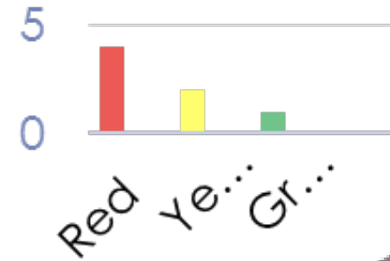
How to Read A Scientific Paper
5.
Results
Provides the data you might need for your own research.
Do you understand what the axes mean in the figures?
Are All Apples Red?
by: YM
Results:
What units are being used?
Abstract: XXXXXXX
Conclusions: XXXXXXX
XXXXXXXXXXXXXXXXXX
XXXXXXX
Introduction: XXXXXXX
XXXXXXXXXXXXXXXXXX
Results: We found four red apples, one green apple, and two yellow apples. See Figure 1.
Methods: XXXXXXX
XXXXXXXXXXXXXXXXXX
References: XXXXXXX
XXXXXXXXXXXXXXXXXX

Slide 8
How to Read A Scientific Paper
6.
The End
Congratulations!
You’ve reached a basic understanding of the paper.
You now know whether the paper is relevant to your work and can pick out any relevant figures and tables.
If you’ve determined that the paper is relevant and worth reading, it is now time for the first reading.

Slide 9
The First Reading
If you’ve gotten this far, it may be useful to print the paper out.
Skim the abstract and introduction once more to make sure you have an adequate understanding of both.
Skim the methods section – if you believe some of the procedures followed will be important for your work then study it carefully.
Read the Results and Discussion sections.
Study and figures and tables.

Slide 10
Increasing Understanding
Re-read the article in its entirety.
You may have to read it more than once.
Write any notes or comments on the article – be sure to highlight any key points you want to come back to later.
Be sure to consult the references. Look up any points or words that you do not understand or were not explained fully.

Slide 11
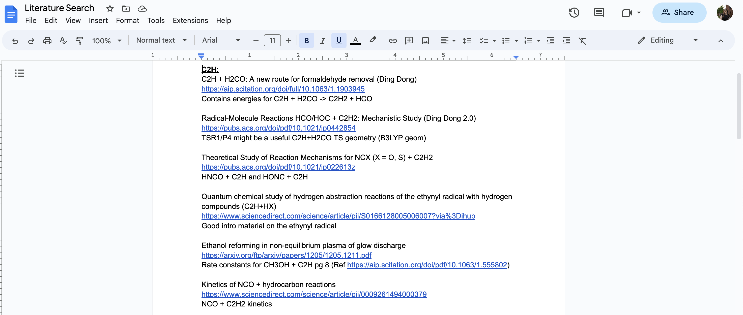
Taking Notes

Slide 12
References
https://www.elsevier.com/connect/infographic-how-to-read-a-scientific-paper
https://web.stanford.edu/~siegelr/readingsci.htm
https://www.lib.purdue.edu/sites/default/files/libraries/engr/Tutorials/Newest%20Scientific%20Paper.pdf
https://resources.nu.edu/researchprocess/readingscientificarticle

Slide 13
Communication

